Slide 1
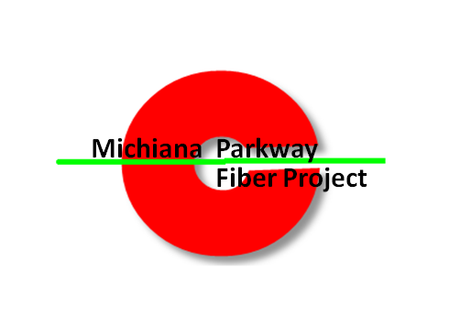
Market Development
An Elkhart County Highway Project
Presented by: Bryan Baker, President
Metro-Manage from

Slide 2
Metro Manage
Market Development Project for The Elkhart County Highway Department
Project Purpose:
- Complete network design,
- Establish upstream connectivity,
- Develop end user sites.
Metro-Manage from

Slide 3
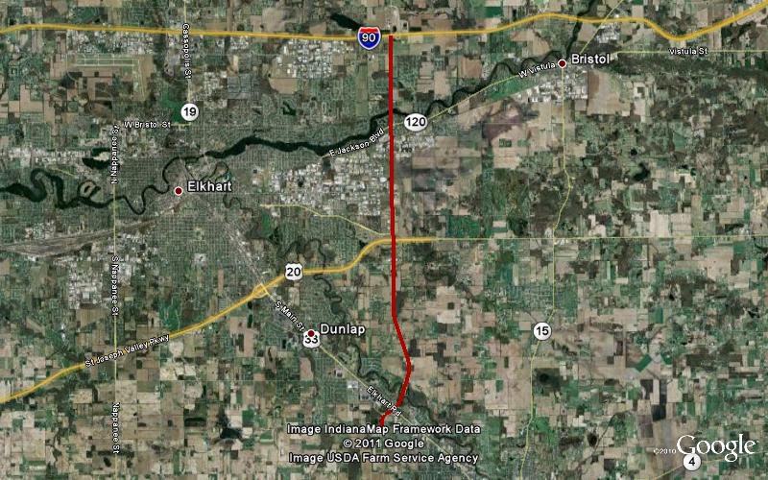
Backbone Network Path

Slide 4
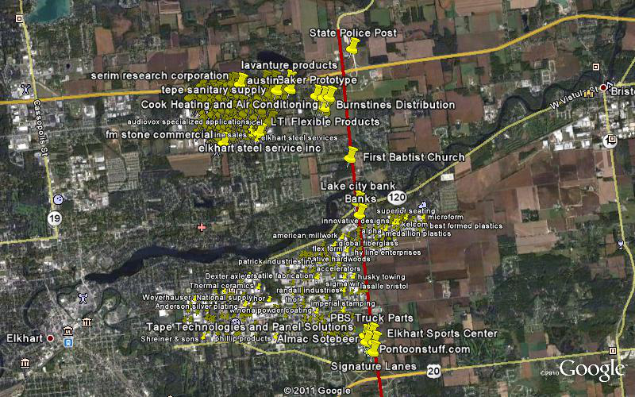
Businesses that can benefit

Slide 5
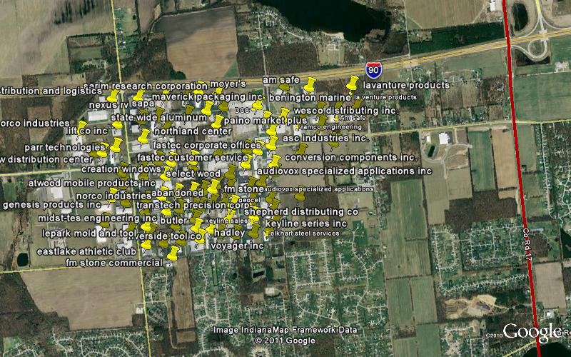
Business Plots North Elkhart

Slide 6
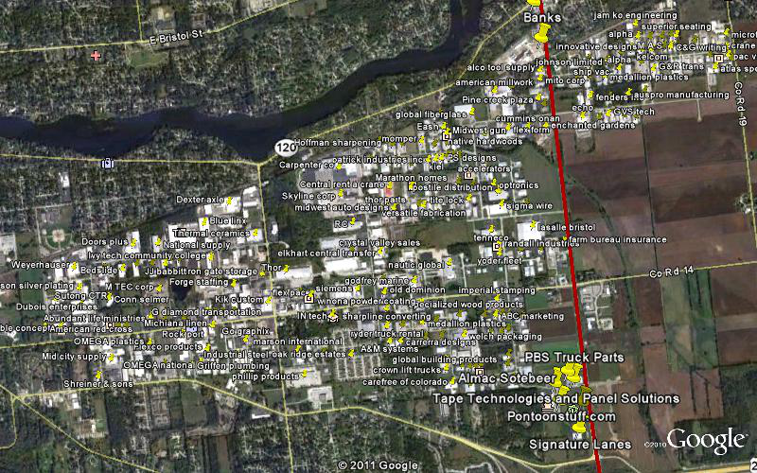
Business Plots South Elkhart

Slide 7
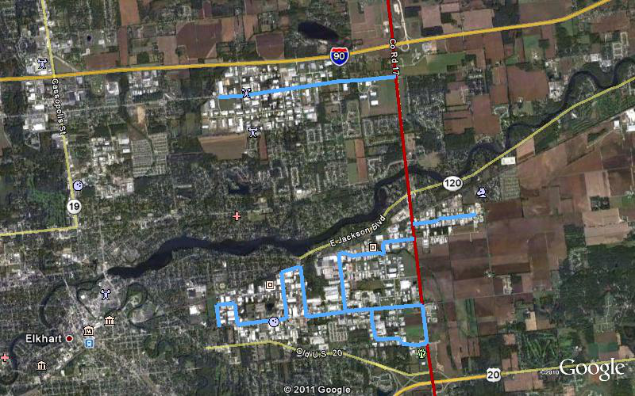
Additional Fiber legs

Slide 8
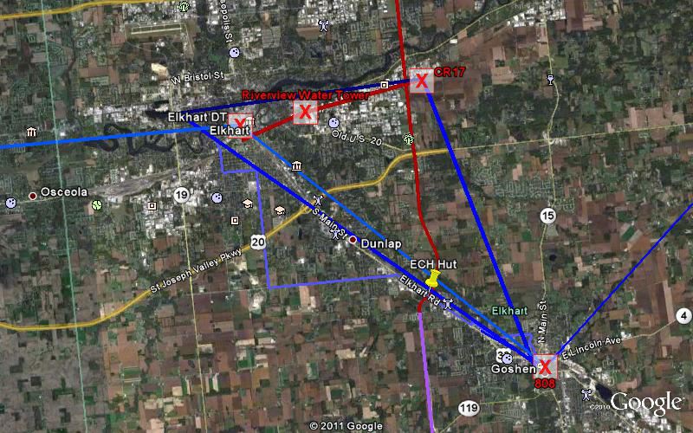
Upstream Cross Connectivity

Slide 9
Market Development: Project Summary
Phase 2 of the Michiana Parkway Fiber Project entailed the solidification of target end user opportunities.
Initial inventory put (278) individual businesses within a two mile reach of the fiber backbone. Upon preliminary rollout there are over a dozen of these businesses requesting additional information. Upon proactive contact, more than 43% of businesses within target range offered a local contact to construct applications with.
Estimated costs for additional fiber legs were as follows:
North: $394,884
South: $88,686

Slide 10
Market Development: Target User Inventory
Count | Company | Address | Contact | Phone
1 | A&M Systems | 4121 Eastland Drive Elkhart, IN 46516-9031 | Brad Miller | (574) 522-5000
1 | Abrasive Blasting & Coating Services | 910 Summa Dr. Elkhart, IN 46516 | Chris Wert | (574) 294-7100
1 | Abc Marketing | 4800 Eastland Drive Elkhart, IN 46516 |  | (574)293-9399
1 | Abi Plastics | 2510 Middlebury Street Elkhart, IN 46516-5512 | Marty Owald | (574) 294-1700
1 | Abundant Life Ministries | 2130 Middlebury St Elkhart, IN 46516 | Andrew England | (574) 522-1800
1 | Acc Climate Control | 22428 Elkhart East Boulevard PO Box 1905 Elkhart, Indiana 46514 |  | (574) 264-2190
1 | Accelerators | 406 Roske Dr, Elkhart, IN 46516 | Todd | (574) 389-7500
1 | Actia | 52765 Bridger Ct Elkhart IN 46514 | Chris Fischer | (574) 264-2373
1 | Adec Industries | 2700 Industrial Pkwy Elkhart, IN 46516 | Evan Hoover | (574) 295-3167
1 | Airgas Great Lakes | 2600 Northland Dr, Elkhart, IN 46514 | Nick Ritucci | (574) 293-9285
1 | Alco Tool Supply | 54847 County Road 17, Elkhart, IN 46516 | Pam Hammers | (574) 295-5535
1 | Al-Ko Kober | 21611 Protecta Dr, Elkhart, IN |  | (574) 294-6651
1 | All-Phase Electrical Supply Co | 2040 Middlebury St, Elkhart, IN 46516 | Paul Highland | (574) 293-5602
1 | Almac Sotebeer | 23805 County Road 6, Elkhart, IN 46514 | Kim Jennings | (574) 264-5507
1 | Alpha Systems | 5120 Beck Dr, Elkhart, IN 46516 | Stephanie Wright | (574) 295-5206
1 | Aluminum Metal | 52760 Bridger Ct, Elkhart, IN 46514 | Anne Lands | (574) 206-2880
1 | Am Safe | 22937 Gallatin Way, Elkhart, IN 46514 | Bryan Tavares | (574) 266-8330
1 | American Millwork | 4840 Beck Dr, Elkhart, IN 46516 | Matt Nicoson | 574) 295-4158
1 | American Red Cross | 721 Riverview Ave, Elkhart, IN 46516 |  | (574) 293-6519
1 | American Steel Rule Die | 3401 Reedy Dr, Elkhart, IN 46514 | Greg Bontrager | 574) 262-3437
1 | Amerimax Building Products | 160 County Road 15, Elkhart, IN 46516 |  | (574) 294-8576
1 | Anderson Silver Plating | 41 Industrial Pkwy, Elkhart, IN 46516 |  | (574) 294-6447
1 | Art Of Design | 104 Rush Ct, Elkhart, IN 46516 | Mike Stephens | (574) 522-8838
1 | Asc Industries | 3604 County Road 6 E, Elkhart, IN 46514 | Mike Burt | (574) 264-1987
1 | Ashland Distro | 3501 Cooper Driver |  | 574 266 4069
1 | Asv Plastics | 3505 Cooper Dr, Elkhart, IN 46514 | Dennis Vance | (574) 264-9694
1 | Atlas Die | 2000 Middlebury St, Elkhart, IN 46516 | Mike D | (574) 295-0050
1 | Atlas Specialty Products | 21066 Protecta Dr, Elkhart, IN 46516 |  | (574) 293-6008
1 | Atwood Mobile Products | 701 Ada Dr, Elkhart, IN 46514 | Bob Devreese | 574) 264-9774
1 | Audiovox Specialized Applications | 2602 Marina Dr, Elkhart, IN 46514 |  | (574) 264-3135
1 | Auspro Manufacturing Co Inc | 21671 Beck Dr, Elkhart, IN 46516 | Randy Heffner | (574) 264-2705
1 | Auto Marketing Services | 921 Verdant St, Elkhart, IN 46516 |  | (574) 522-6646
1 | Axis Products | 3403 Reedy Dr, Elkhart, IN 46514 | Steve Romanowski | (574) 266-8282
1 | Baker Prototype | 53050 Elkhart E Blvd, Elkhart, IN 46514 |  | (574) 266-7223
1 | Banks Concrete | 4331 Pine Creek Rd |  | 574 264 0196
1 | Bed Slide | 2111 Industrial Parkway |  | 574 295 8271
1 | Bennington Marine | 2805 Decio Dr, Elkhart, IN 46514 | Steve Riley | (574) 264-6336
1 | Best Formed Plastics | 21099 Protecta Drive Elkhart, IN 46516-9704 | Bob LeMieux | (574) 293-6128
1 | Blue Linx | 225 Collins Road Elkhart, IN 46516-5423 | Jack Forness | (574) 295-0214

Slide 11
Market Development: Target User Inventory
1 | Building Business Collectively Distribution Llc | 53320 Columbia Dr. |  | 574 266 3601
1 | Burnstines Distribution | Elkhart, IN 46514 | Karley Keggerreis | (574) 266-7676
1 | Burston Marketing | 52950 Frederic Dr, Elkhart, IN 46514 | Tim Garber | (574) 262-4005
1 | C&G Wiring | 21325 Protecta Drive Elkhart, IN 46516 | Misty Reese | (574) 523-0400
1 | Can Do Tire | 21354 Protecta Dr, Elkhart, IN 46516 |  | (574) 296-7750
1 | Capital Tire | 1132 BRESSEAU St |  | 574 294 6152
1 | Carefree Of Colorado | 4507 Chester Dr, Elkhart, IN 46516 | Dave Frazell | (574) 389-5060
1 | Carpenter | 195 County Road 15, Elkhart, IN 46516 | Bryan Johnson | (574) 522-2800
1 | Carrera Designs | 1101 Herman St, Elkhart, IN 46516 | Pam Hayes | (574) 295-7907
1 | Central Rent A Crane | 4240 Pine Creek Rd, Elkhart, IN 46516 | Kristi Hesselbart | (574) 295-8877
1 | Champion Manufacturing Inc | 2601 Industrial Pkwy, Elkhart, IN 46516 |  | (574) 295-6893
1 | Cleer Vision Windows | 25120 Leer Dr, Elkhart, IN 46514 | Rick Shreiner | (574) 262-0449
1 | Cmg | 1838 Middlebury St, Elkhart, IN 46516 |  | 574 522 7893
1 | Comcast | 21124 Protecta Dr
1 | Conn-Selmer, Inc | 21124 Protecta Dr | John Poeppelman | (574) 522-1675
1 | Cook Heating And Air (Service Experts) | Elkhart, IN |  | (574) 830-8104
1 | Crane Composites | 21125 Protecta Dr, Elkhart, IN 46516 |  | (574) 522-0868
1 | Creation Windows-Indiana, Inc | 2701 Ada Dr, Elkhart, IN 46514 | Bob Devreese | (574) 264-3131
1 | Crown Lift Trucks | 1125 Herman St, Elkhart, IN 46516 | Chuck Woods | (574) 389-8393
1 | Crystal Valley Sales | 4100 Bullard Rd, Elkhart, IN 46516 | Charlie Kline | (574) 295-7599
1 | Onan-Indiana | 5125 Beck Dr, Elkhart, IN 46516 | John Sanders | (574) 389-9510
1 | Cutting Edge Laser | 5018 Green Ct, Elkhart, IN 46516 |  | (574) 389-3434
1 | Days Distribution and Logistics | 3300 Reedy Road |  | 574 262 9525
1 | Dcc Inc | 2507 Decio Dr, Elkhart, IN 46514 | Rick Donati | (574) 262-2621
1 | Design Time | 21 Summa Dr, Elkhart, IN 46516 |  | (574) 522-5202
1 | Dexstar | 400 Collins Road |  | 574 295 3535
1 | Dexter Axle | 2900 Industrial Pkwy, Elkhart, IN 46516 | Brian Bowman | (574) 295-7888
1 | Ea Technologies | 2501 Jeanwood Dr, Elkhart, IN 46514 | Steve | (574) 266-7356
1 | Disabled American Veterans | 1205 Middleton Run Rd, Elkhart, IN 46516 | Larry Swartzell | (574) 293-0761
1 | Dometic | 2320 Industrial Pkwy, Elkhart, IN 46516 | Greg Thrasher | (574) 294-2511
1 | Doors Plus | 2100 Industrial Pkwy, Elkhart, IN 46516 |  | (574) 522-6700
1 | Dubois Enterprises | 30561 Old US 20, Elkhart, IN 46514 |  | (574) 389-8844
1 | Dumor Water Specialist | 4405 Wyland Dr, Elkhart, IN 46516 |  | (574) 522-9500
1 | Dynamax | 2745 Northland Dr, Elkhart, IN 46514 |  | (574) 262-3474
1 | E Industries | 4526 Chester Drive |  | 574 522 7550
1 | Eash Industries | 120 Rush Court |  | 574 295 4450
1 | Eastlake Athletic Club | 3400 Henke St, Elkhart, IN 46514 | Stephanie | (574) 264-0611
1 | Eaton Leonard Tooling | 435 Roske Dr, Elkhart, IN 46516 | Jeff Jacobs | (574) 295-5041
1 | Echo | 21888 Beck Drive
1 | Edward Jones | 5230 Beck Dr Ste 6, Elkhart, IN 46516 |  | 574) 389-8616
1 | Efp | 223 Middleton Run Rd, Elkhart, IN 46516 | Gene Lasarenko | (574) 295-4690
1 | Elixir | 640 Collins Rd, Elkhart, IN 46516 | Rob Cunnighham | (574) 294-5685
1 | Elkhart Central Transfer | 610 County Road 15, Elkhart, IN 46516 |  | (574) 295-4550
1 | Elkhart Hitch Shop | 3502 Cooper Dr, Elkhart, IN 46514 | Valerie Nusbaumens | (574) 266-0475
1 | Elkhart Sports Center | 1162 Fremont Ct, Elkhart, IN 46516 |  | 574) 294-5050
1 | Elkhart Steel Services | 3604 Henke St, Elkhart, IN 46514 | Kim Hampel | (574) 262-2552
1 | Elkhart Fabricating (EMD) | 23410 CR 6 |  | 574 266 8212
1 | Linton'S Floral & Interior | 315 County Road 17, Elkhart, IN 46516 |  | (574) 293-9699
1 | Esco Pex Products | 1126 Kent St, Elkhart, IN 46514 |  | (574) 264-4156
1 | F&F Grinding Service (Elkhart Grinding Service, Inc) | 121 Rush Ct, Elkhart, IN 46516 |  | (574) 293-2707
1 | F&F Screw Machine Products | 4302 Wyland Dr, Elkhart, IN 46516 | Roger Duffy | (574) 293-0362

Slide 12
Market Development: Target User Inventory
1 | Farm Bureau Insurance | 631 County Road 17, Elkhart, IN 46516 | Jerry | (574) 295-4488
1 | Fasnap | 3500 Reedy Dr, Elkhart, IN 46514 | Blair Barsell | (574) 264-1185
1 | Fastenal | 1149 Mitchell Jellison Dr, Elkhart, IN 46516 |  | (574) 293-6599
1 | Fenders Inc | 21821 Beck Dr, Elkhart, IN 46516 | Troy | (574) 293-3717
1 | First Babtist Church | 53953 County Road 17, Bristol, IN 46507 | Elizebeth Etner | 574) 295-4475
1 | Fit Stop | 5230 Beck Dr, Elkhart, IN 46516 |  | (874) 333-3509
1 | Fleming Sales | 2101 Industrial Parkway, P.O. Box 277 Elkhart, IN 46515 | mike fleming | (574) 295-0234
1 | Flexform Technologies | 4955 Beck Dr, Elkhart, IN 46516 | Gilbert Young | (574) 295-3777
1 | Flex Pac | 3310 Middlebury St, Elkhart, IN 46516 | Ryan | (574) 293-3435
1 | Flexco Products | 2415 Bryant St, Elkhart, IN 46516 |  | 574) 294-2502
1 | Flexible Concepts | 1620 Middlebury St, Elkhart, IN 46516 | Matt kratzer | (574) 296-0941
1 | Forge Industrial Staffing | 700 Collins Rd, Elkhart, IN 46516 |  | (574) 293-2400
1 | G Diamond Transport | 2500 Middlebury St # 2, Elkhart, IN 46516 |  | (574) 293-7858
1 | G&R Transportation | 21412 Protecta Dr |  | 574 266 8201
1 | Gaylor Electric Inc | 2509 Ada Dr, Elkhart, IN 46514 |  | (574) 295-2112
1 | Gdc | 21209 Protecta Dr, Elkhart, IN 46516 |  | (574) 970-1019
1 | Genesis Products | 2608 Almac Ct, Elkhart, IN 46514 | Eric H | (574) 266-8292
1 | Geocel | 2504 Marina Dr, Elkhart, IN 46514 | Mike Sherck | (574) 264-0645
1 | Gibson Fiberglass | 4800 Beck Dr,Elkhart,IN46516 | Len Chen | (574) 293-3800
1 | Global Building Products | 1121 Herman St Elkhart, IN 46516 | Clayton Djurstrom | (574) 296-6868
1 | Global Group | 2310 Industrial Pkwy Elkhart, IN 46516 |  | 574-389-8882
1 | Global Link Imports | 1137 Verdant Drive Elkhart, IN. 46516 | David Pairitz | 888-400-2872
1 | Markley Enterprises | 800 Lillian Avenue Elkhart, IN 47616 | Dorothy | 574-295-4195
1 | Nautic Global Group | 4500 Middlebury Street Elkhart IN 46516 | Chris Laware | 574-522-8381
1 | Greenball Corp | 21861 Protecta Drive Elkhart, IN 46516-9544 |  | (574) 522-4000
1 | Griffen Plumbing | 2310 Toledo Road Elkhart, IN 46516 | Todd Dies | (574) 295-2440
1 | Gvs Tech | 1744 Beck Drive Elkhart, IN 46516-9742 | Michelle | (574) 293-0974
1 | Helgson Steel Inc | 1130 Verdant St # 1 Elkhart, IN 46516-9330 | Christine Helgeson | (574) 293-5576
1 | Hadley | 2503 Marina Drive Elkhart, IN 46514-8641 |  | (574) 293-5669
1 | Hardwoods Specialty Products | 4221 Wyland Dr, Elkhart, IN 46516 | Colby | (574) 295-7600
1 | Hb Fuller | 3200 County Road 6 E, Elkhart, IN, 46514-7661 | Joe Hoppert | (574) 264-9614
1 | Hoffman Sharpening | 4216 Wyland Drive Elkhart, IN 46516-9518 | Chris Hughey | (574) 293-6317
1 | Horner Investments | 818 E Bristol Street Elkhart, IN 46514-3414 |  | (574) 262-2050
1 | Husky Towing
1 | Hy Line Enterprises | 21674 Beck Drive Elkhart, IN 46516-9632 | Suzanne | (574) 294-1112
1 | Imperial Stamping | 4801 Middlebury Street Elkhart, IN 46516-9054 |  | (574) 294-3780
1 | In Plastics | 2221 Industrial Parkway Elkhart, IN 46516 | Steve Burns | (574) 294-3253
1 | In Tech | 3333 Middlebury Street Elkhart, IN 46516-5587 |  | (574) 389-8324
1 | Indiana State Police | 52422 County Road 17 Elkhart, IN 46514 | Jeff Meyers | (574) 206-2931
1 | Industrial Finishes | 123 Verdant St Elkhart, IN 46516-9045 | Angela Williams | (574) 293-9920
1 | Industrial Steel (Flexco Products) | 2415 Bryant Street Elkhart, IN 46516-5536 |  | (574) 293-2558
1 | Innovative Designs | 21537 Protecta Drive Elkhart, IN 46516-9542 |  | (574) 970-3107
1 | Iron Gate Storage | 2921 Johnson Street Elkhart, IN 46514-5569 | Aimee | (574) 264-5598
1 | Irvine Shade & Door Inc | 1000 Verdant Street Elkhart, IN46516-9042 | Tracy Mausar | (574) 522-1446
1 | Itc | 1015 Verdant Street Elkhart, IN 46516-9043 | Brandon Decker | (574) 389-8986
1 | Ivy Tech Comm College | 2521 Industrial Pkwy,Elkhart,IN46516 |  | (574) 293-4657
1 | Jamko Engineering Co | 21496 Buckingham Rd,Elkhart,IN46516 |  | (574) 294-7684
1 | Jj Babbitt | 2201 Industrial Pkwy,Elkhart,IN46516 |  | (574) 293-6514
1 | Johnson Ltd | 21685 Protecta Dr,Elkhart,IN46516 |  | (574) 293-1605

Slide 13
Market Development: Target User Inventory
1 | Johnstone Supply | 3314 Middlebury St,Elkhart,IN46516 | IT | (574) 970-0628
1 | Jsi | 21525 Beck Dr,Elkhart,IN46516 | Dave Clark | (574) 262-2399
1 | Kd Vintage | 3401 Cooper Dr,Elkhart,IN46514 | Mike Hunter | (574) 266-8800
1 | Kelcom | 21419 Protecta Dr,Elkhart,IN46516 | Randy Campion | (574) 522-2212
1 | Kellmark | 2501 Ada Dr,Elkhart,IN46514 | Jim Kelly | (574) 264-9695
1 | Kem Krest | 2040 Toledo Rd,Elkhart,IN46516 | Darrin Zuroff | (574) 389-2650
1 | Keyline Sales | 2502 Marina Dr, Elkhart, IN 46514 |  | (574) 294-5611
1 | Kib | 53404 County Road 13, Elkhart, IN 46514 | Brian Milovich | (574) 262-0518
1 | Kiel Na | 4519 Wyland Dr, Elkhart, IN 46516 | Mark Walter | (574) 293-3600
1 | Kik Custom | 2825 Middlebury St,Elkhart,IN46516 |  | (574) 295-0000
1 | Lake Cable | 4430 Eastland Dr,Elkhart,IN46516 |  | (574) 296-7017
1 | Lake City Bank | 22050 State Road 120,Elkhart,IN46516 | Joanie Forman - IT | (574) 522-2536
1 | Lasalle Bristol | 601 County Road 17,Elkhart,IN46516 | Mike Caldwell | (574) 295-4400
1 | Liftco | 3301 Reedy Dr, Elkhart, IN 46514 | J Disher | (574) 266-5551
1 | Lincoln Chemical | 4331 Eastland Dr, Elkhart, IN 46516 | W campbell | (574) 970-0444
1 | Lavanture Products | 22825 GALLATIN WAY, ELKHART, IN, 465147651 | Brandon Wiese | (574) 264-0658
1 | Lti Flexible Products | 53208 Columbia Drive Elkhart, IN 46514 | Nicole | (574) 389-1878
1 | M.A.S. | 559 Protecta Drive Elkhart, Indiana 46516 | Debbie | 574-294-6905
1 | Marathon Homes | 4420 Pine Creek Road Elkhart, IN 46516-9560 | Ron Burg | (574) 294-6441
1 | Marson International | 3230 Magnum Dr,Elkhart,IN46516 |  | (574) 295-4222
1 | Maverick Packaging | 3505 Reedy Dr,Elkhart,IN46514 | Tom Mcglone | (574) 264-2891
1 | Medallion Plastics | 21700 Protecta Dr,Elkhart,IN46516 | Shirley Jewell | (574) 522-7527
1 | Mg Products | 21325 Protecta Dr,Elkhart,IN46516 | Chad | (574) 293-0752
1 | Michiana Linen | 2505 Middlebury St, Elkhart, IN 46516 |  | (574) 522-5700
1 | Microform | 21053 Protecta Dr # A,Elkhart,IN46516 |  | (574) 522-9851
1 | Mid City Supply | 940 Industrial Pkwy, Elkhart, IN 46516 | David Ganger | (574) 294-5551
1 | Midstates Tool & Die | 3407 Cooper Dr, Elkhart, IN 46514 |  | (574) 264-3521
1 | Midwest Auto Designs | 4251 Pine Creek Rd,Elkhart,IN46516 | Jason | (574) 522-4878
1 | Midwest Gun | 128 Rush Ct,Elkhart,IN46516 | Todd - IT | (574) 293-2030
1 | Mito Corp | 54905 County Road 17, Elkhart, IN 46516 |  | (574) 295-2441
1 | Momper Installed | 4500 Wyland Dr,Elkhart,IN46516 | Keith Bennett | (574) 295-1683
1 | Mor Ryde | 1966 Moyer Ave, Elkhart, IN 46516 | Billy | (574) 293-1581
1 | Motion Industries | 4709 Wyland Dr,Elkhart,IN46516 | Larry Guyton | (574) 293-4343
1 | Motor Electric | 4700 Eastland Dr,Elkhart,IN46516 | Darren | (574) 294-7123
1 | Moyers | 3502 Reedy Dr,Elkhart,IN46514 | george moyer | (574) 264-3119
1 | M Tec Corp | 2210 Middlebury St,Elkhart,IN46516 |  | (574) 294-1060
1 | National Supply | 2200 Industrial Pkwy,Elkhart,IN46516 | Josh Mills | (574) 295-9200
1 | Native Hardwoods | 316 Roske Dr, Elkhart, IN 46516 | Scott Edmonton | (574) 293-9690
1 | Nav Steel | 21790 Beck Dr,Elkhart,IN46516 | Emily | (574) 296-7456
1 | New Generation Caterers | 21712 Beck Dr, Elkhart, IN 46516 | John Beck | (574) 333-3156
1 | Nexus Rv | 3400 Reedy Dr, Elkhart, IN 46514 | R Yoder | (574) 970-0848
1 | Nibco | 1516 Middlebury St, Elkhart, IN 46516 | D Warren | (574) 295-3000
1 | Nobi | 2506 Middlebury Street Elkhart, IN 46516-5512 |  | (574) 295-5765
1 | Norco Industries Inc | 2600 Jeanwood Dr, Elkhart, IN 46514 | Brent Heffner | (574) 262-3400
1 | Norcold Warehouse | 3503 Cooper Dr,Elkhart,IN46514 | Sue Mcguire | (574) 266-6660
1 | Northland | 23805 County Road 6 Elkhart, IN 46514 | Mitch Rapp | (574) 262-2576
1 | Nortool Precision (Norco Industries) | 2600 Jeanwood Dr,Elkhart,IN46514 | Brent Heffner | (574) 262-3400
1 | Oak Ridge Estates | 1201 County Road 15, Elkhart, IN 46516 | Brenda Radcliff | (574) 522-4650
1 | Old Dominion Truck | 750 County Road 15 Elkhart, IN 46516 | Tony | (574) 295-1285
1 | Omega National | 1010 Rowe St, Elkhart, IN 46516 | Phil DeLee | (574) 295-5353
1 | Omega Plastic | 2123 Middlebury St,Elkhart,IN46516 | Mike Hochedler | (574) 295-2413

Slide 14
Market Development: Target User Inventory
Optronics | 420 Roske Dr, Elkhart, IN 46516 | corporate office in TN | (574) 389-0040
Pac Van Leasing | 21075 Protecta Dr # X, Elkhart, IN 46516 |  | (574) 293-5550
Paramount Plastics | 2810 Jeanwood Dr,Elkhart,IN46514 | Pat Stover | (574) 264-2143
Pastle Dist.
Pauls Seating Inc | 56912 Elk Ct,Elkhart,IN46516 |  | (574) 522-0630
Pbs Truck Parts | 5035 Verdant St,Elkhart,IN46516 | handled in SB office 574-289-1044 Don Walker | (574) 296-9700
Penske Truck Rental | 2220 Toledo Rd,Elkhart,IN46516 |  | (877) 238-6692
Phillip Products | 3221 Magnum Drive, Elkhart, IN, 46515 |  | (574) 296 0000
Phoenix Usa Inc | 2601 Marina Dr,Elkhart,IN46514 | karen | (574) 266-2020
Piano Market Plus | 52896 County Road 113 |  | 574 674 6220
Pine Creek Auto Wash | 5216 Beck Dr # 15,Elkhart,IN46516 |  | (574) 333-2486
Pinnacle Seating | 1011 Herman St,Elkhart,IN46516 | Andy Stite - owner | (574) 522-2636
Polytron | 4400 Wyland Dr,Elkhart,IN46516 | Ralph | (574) 522-0246
Pontoonstuff.Com | Fremont Court Elkhart, IN 46516-9320 |  | (574) 970-0003
Positron Corp | 4614 Wyland Dr,Elkhart,IN46516 | Ray Swers - owner | (574) 295-8777
Precision Stamping | 720 Collins Rd,Elkhart,IN46516 | owner | (574) 522-8987
Pro Fleet Trans. | 601 Middleton Run Rd, Elkhart, IN 46516 | Beth | (574) 522-4415
Prolon | 1040 Sako Ct,Elkhart,IN46516 | Chris Eaton | (574) 522-8900
PS Designs | 52876 Harman Drive |  | 866-652-4665
Quality Engineering Products | 56802 Elk Ct, Elkhart, IN 46516 | D Davis | 574) 294-6943
Quiznos | 5230 Beck Dr # 1,Elkhart,IN46516 |  | (574) 295-6688
Ramco Engineering | 52965 Frederic Dr, Elkhart, IN 46514 |  | (574) 266-1455
Randall Industries | 553 Verdant St,Elkhart,IN46516 | Scott Paisker - IT | (574) 295-4100
Recreation By Design | 21746 Buckingham Rd,Elkhart,IN46516 | Josh Stanter | (574) 294-2117
River Park Inc | 21953 Protecta Dr, Elkhart, IN 46516 | Matt Sweet - IT | 574) 522-7781
Riverside Tool Corp | 3504 Henke St, Elkhart, IN 46514 |  | (574) 522-6798
Rockport | 2323 Middlebury St |  | 574 295 1022
Rtw Enterprises ` | 2924 County Road 6 E, Elkhart, IN 46514 | shaun wisk | (574) 294-3275
Ryder Truck Rental | 4120 Eastland Drive |  | 574 295 3747
Sapa Extrusions Inc | 3406 Reedy Dr, Elkhart, IN 46514 |  | (574) 262-2667
Schuster Sheet Metal | 418 Roske Dr, Elkhart, IN 46516 |  | (574) 293-4802
Scope Technologies | 2135 Industrial Pkwy, Elkhart, IN 46516 | IT Manager | 574) 295-0229
Selena Usa | 21715 Beck Dr, Elkhart, IN 46516 | general box | (574) 523-0400
Serim | 3506 Reedy Dr, Elkhart, IN 46514 | Andrew Van Dyck | (574) 264-3440
Sharpline Auto | 23163 US Highway 33, Elkhart, IN 46517 |  | (574) 875-6716
Shelter Insurance | 330 County Road 6 E Ste 3,Elkhart,IN46514 |  | (574) 849-8540
Ship-Pac | 54900 County Road 17, Elkhart, IN 46516 |  | (574) 293-0779
Shreiner & Sons | 1035 Industrial Pkwy,Elkhart,IN46516 | Shirley Chomer | (574) 293-8677
Siemens Obs | 3400 Middlebury St,Elkhart,IN46516 |  | (574) 522-4187
Sigma Switches | 4703 Wyland Drive Elkhart, IN 46516-9681 | Owner | (574) 294-5776
Sigma Wire International | 4906 Hoffman Street Elkhart, IN 46516-9075 |  | (574) 295-9660
Signature Lanes | 1180 Fremont Court Elkhart, IN 46516-9321 | Mr. Yoder | (574) 296-1111
Sirco | 4531 Chester Drive Elkhart, IN 46516-9056 | Mark | 574) 294-5487
Skyline Corp | 2520 Bypass Rd Elkhart in |  | (574) 294-6521
Specialized Wood Products | 4221 Middlebury Street Elkhart, IN 46516 |  | (574) 522-6376
Speedgrip Chuck | 2000 Industrial Parkway Elkhart, IN 46516-5411 | Brian Palmer | (574) 294-1506
Stacks Pancakes | 5230 Beck Dr Elkhart, IN 46515 |  | (574) 333-3910
Standard Label Co | 4200 Wyland Dr, Elkhart, IN 46516 |  | (574) 522-3548
Statewide Aluminum | 3518 County Road 6 E, Elkhart, IN 46514 |  | (574) 262-2594
Summit Seating | 2601 Northland Dr, Elkhart, IN 46514 |  | (574) 262-0871
Superior Seating | 21468 C St, Elkhart, IN 46516 | Cindy Bontrager | (574) 389-9011
Superior Space | 53400 County Road 113, Elkhart, IN 46514 | Gary - owner | (574) 206-8900

Slide 15
Market Development: Target User Inventory
Sutong China Tire Resource (Ctr) | 603 Industrial Pkwy, Elkhart, IN 46516 | Howard | (574) 293-1100
Swanson Staffing | 655 County Road 17 Ste 5, Elkhart, IN 46516 | Denise Kulp | (574) 294-6033
Tape Technologies And Panel Solutions | 5015 Verdant St |  | 574 389 8494
Tapley'S Pro Shop | 1180 Fremont Ct, Elkhart, IN 46516 | Scott Tapley | (574) 303-5592
Tcb Industries | 4600 Wyland Dr, Elkhart, IN 46516 |  | (574) 522-3971
Temple Products (Division Of Postle Aluminum Company) | 4511 Pine Creek Rd, Elkhart, IN 46516 |  | (574) 294-3621
Tenneco | 4825 Hoffman St |  | 574 296 9400
Tepe Sanitary Supply | 52878 Frederic Dr Elkhart, IN 46514-7637 |  | (574) 293 -7591
Thermal Ceramics | 2730 Industrial Pkwy, Elkhart, IN 46516 | Jorge Martinez | (574) 296-3500
Thor | 3080 Windsor Ct, Elkhart, IN 46514 |  | (574) 970-7460
Time Out Trailers | 4636 Chester Dr, Elkhart, IN 46516 |  | (574) 294-7671
Titan Sales & Consulting | 4530 Chester Dr, Elkhart, IN 46516 |  | (574) 271-1703
Tite Lok | 4715 Pine Creek Rd |  | 574 295 1300
Troeger Metal Works | 2603 Marina Dr Elkhart, IN 46514-8642 |  | (574) 262-5300
Trp International | 21840 Protecta Dr, Elkhart, IN 46516 |  | (574) 389-9941
Tumacs Corp | 3505 Cooper Dr, Elkhart, IN 46514 |  | (574) 264-5000
Tuscany Motor Coach | 2811 Tuscany Drive Elkhart, IN46514-7639 | Lisa Ross | (574) 389-9000
Twin Air Products | 4602 Chester Dr, Elkhart, IN 46516 |  | (574) 295-1129
Utility Body Werks | 21912 Protecta Dr, Elkhart, IN 46516 |  | (574) 522-8422
Vahala Foam | 930 Herman St, Elkhart, IN 46516 |  | (574) 293-1287
Versa Machinery | 4850 Green Ct, Elkhart, IN 46516 |  | (574) 266-0780
Versatile Fabrication | 4431 Pine Creek Rd, Elkhart, IN 46516 |  | (574) 293-8504
Villa International | 4733 Eastland Drive |  | 574 389 8383
Vincent Bach Division (Conn-Selmer) | 500 Industrial Pkwy, Elkhart, IN 46516 | John Poeppelman | (574) 295-6730
Vintage Trailers | 4660 Pine Creek Rd, Elkhart, IN 46516 | John E | (574) 522-2261
Vitracoat America | 2807 Marina Dr, Elkhart, IN 46514 | Lori Beam - Operations Manager | (574) 264-6090
Voyager | 2500 Ada Dr, Elkhart, IN 46514 |  | (574) 264-9504
Welch Packaging | 1020 Herman St, Elkhart, IN 46516 | Alan Wine | (574) 295-2460
Wesco | 3603 County Road 6 |  | 574 262 2505
Weyerhauser | 1810 Conant St, Elkhart, IN 46516 |  | (574) 293-2511
Wightman Petrie | 4703 Chester Dr, Elkhart, IN 46516 | Kip Keck - IT | (574) 293-7762
Winona Powder Coating | 800 Summa Dr, Elkhart, IN 46516 |  | (574) 294-6662
Wire Design | 520 Industrial Pkwy, Elkhart, IN 46516 |  | 574) 293-2990
Wesco | 23192 Gallatin Way |  | 574 206 1517
Yoder Fleet Express | 613 Verdant St, Elkhart, IN 46516 |  | (574) 389-1530

